Slide 1
Unlocking Personalised Outcomes
Charlotte Dugdale – Strategy & Engagement Manager

Slide 2
TSA MISSION > PARTNERSHIPS – DATA – PEOPLE - STANDARDS
TRANSFORMATION AND GROWTH OF TEC SECTOR

Slide 3
01

Slide 4
Technology across Health and Social care
Telecare/ Telehealth/Telemedicine
Artificial intelligence
Personal and wearable devices
Internet of things
Electronic planning systems
Apps/Software

Slide 5
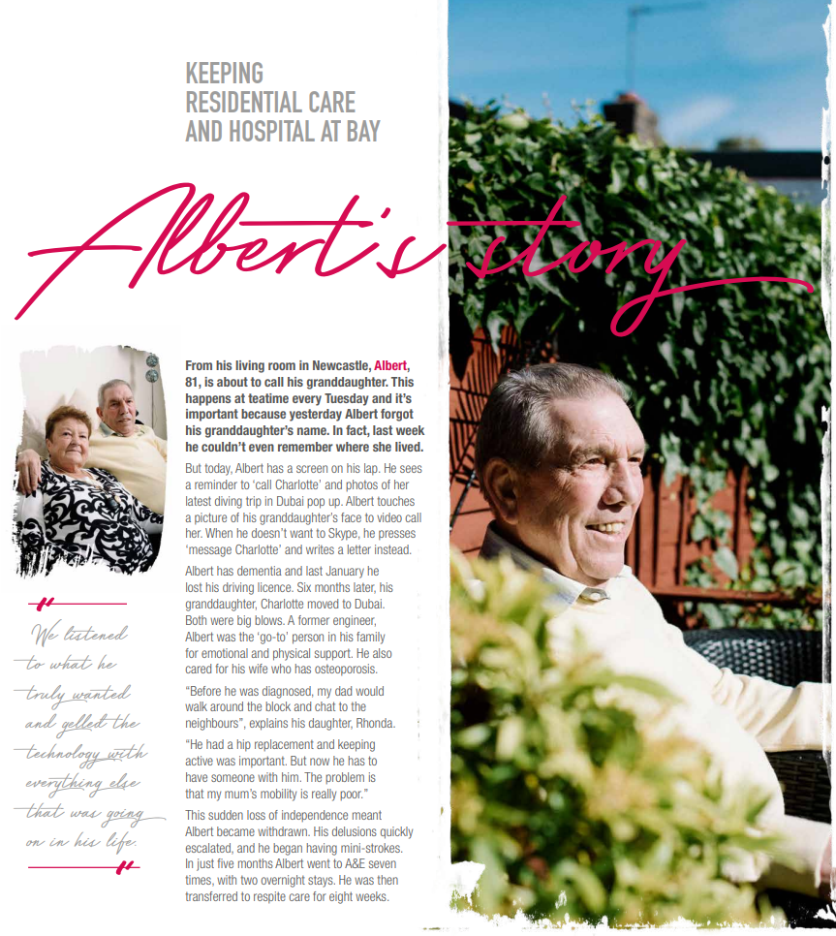
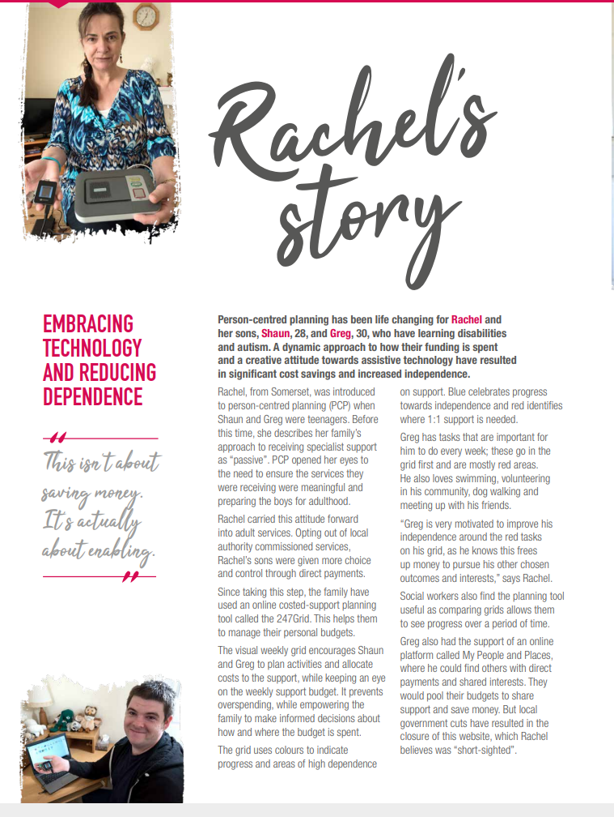
https://www.tsa-voice.org.uk/campaigns/telling-the-tec-story/tec-stories/

Slide 6
MOLE VALLEY LIFE
PROACTIVE MONITORING THAT
SLOWS HEALTH DECLINE
96, lives alone, dementia, poor sight
MEET
Fell, discharged from hospital
ALF
24/7 live-in care
A VERY PERSONAL STORY
Basic, reactive telecare alarm

Slide 7
MOLE VALLEY LIFE
PROACTIVE MONITORING THAT
SLOWS HEALTH DECLINE
Lifestyle monitoring system installed
Data shows he can manage without 24/7 care
Package reduced to 2 visits per day
Given falls detector and digital lifeline alarm
Alf now lives happily and safely at home with monitoring:
MEET
Avoided: care home move
ALF
A VERY PERSONAL STORY
Avoided: 24/7 live-in care
Saved: £760/ week care costs

Slide 8
MOLE VALLEY LIFE
PROACTIVE MONITORING THAT
SLOWS HEALTH DECLINE
MEET
ALF
1
Mole Valley Life & Surrey County Council
3
Benefits
Joint pilot with clear aim:
Evidence helps decision-making
Reassurance for daughter
Personalised care for Alf
Boosts independence & control
Regular toilet visits flagged to GP
Care package reduced
Enabling people to live independently in own homes for longer
Blend of TEC, trusted advisors, monitoring & reablement
A VERY PERSONAL STORY
2
Process
Lifeline alarm
Alf referred via Discharge 2 Assess
Trusted advisor assesses
Goals identified
TEC gathers evidence on lifestyle
Data informs care & support
NOW £217.60/ WEEK
Wrist-worn fall detector
LIVE-IN CARE WORKER COST £981.75/ WEEK
24HR CARE REDUCED TO 2 VISITS PER DAY
£190
(CARER)
£27.60
Home lifestyle monitoring kit
(TEC)

Slide 9
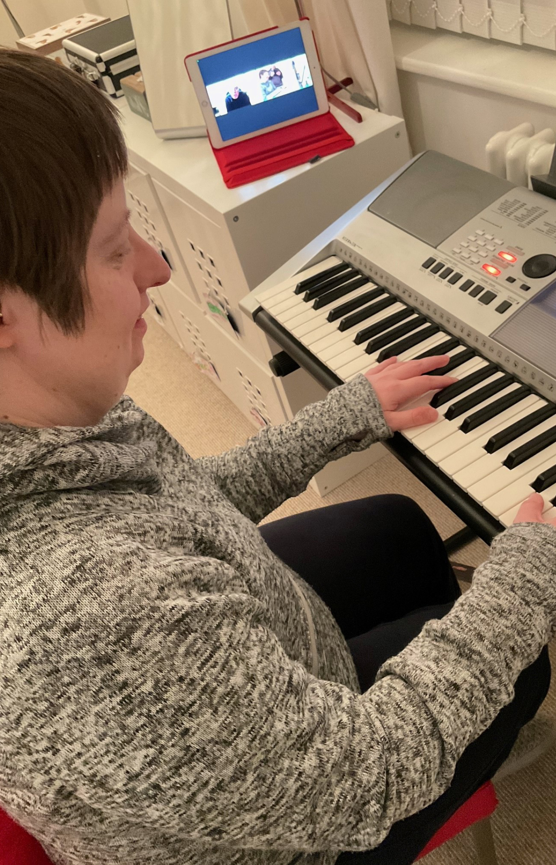
SELF-FUNDER
HOW TEC EQUIPMENT CAN
IMPROVE INDEPENDENCE
44, autism, Down’s syndrome, anxiety
MEET
Lives alone, parents live next door
ANNA
24/7 live-in care
A VERY PERSONAL STORY

Slide 10
SELF-FUNDER
HOW TEC EQUIPMENT CAN
IMPROVE INDEPENDENCE
Devices remind Anna about daily tasks
Home monitoring system installed
Sensors alert parents to routine change overnight
Package reduced to 8am-11pm (sleep-ins removed)
Anna (and her parents) feel reassured by TEC:
MEET
ANNA
Avoided: 24/7 live-in care
A VERY PERSONAL STORY
Saved: £770/ week sleep-in costs

Slide 11
SELF-FUNDER
HOW TEC EQUIPMENT CAN
IMPROVE INDEPENDENCE
MEET
ANNA
1
Council & self- funded support
3
Benefits
Council TEC assessor provided advice
Identified equipment that gave reassurance at night & boosted independence in day
Carers leave at 11pm
Independence for Anna
Reassurance for parents
Social connection to friends
Savings for local authority
A VERY PERSONAL STORY
2
Technology
Keyboard lessons via tablet
Family calls via video chat portal
Reminders flagged by independent living tablet
Routine changes monitored by sensors
£110
£250
BUT MOST TEC COVERED BY DIRECT PAYMENT
PER NIGHT SLEEP-IN COST SAVED
PER YR FOR TEC PAID BY FAMILY

Slide 12
https://bridgit.care/contents/
https://asksara.livingmadeeasy.org.uk/selector
Helpful Links

Slide 13
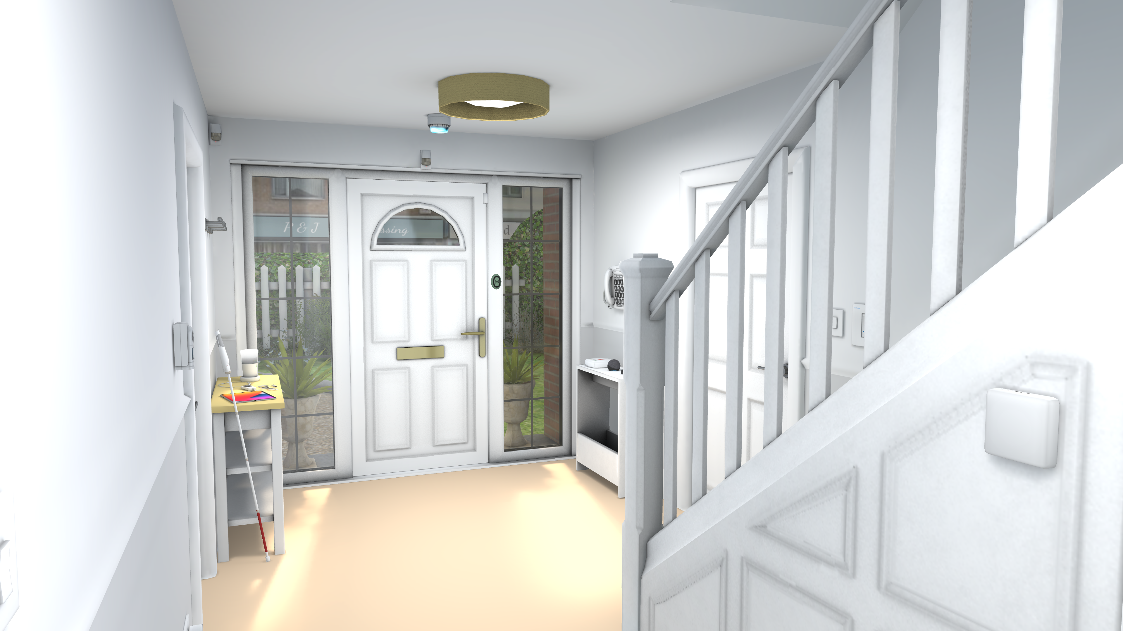
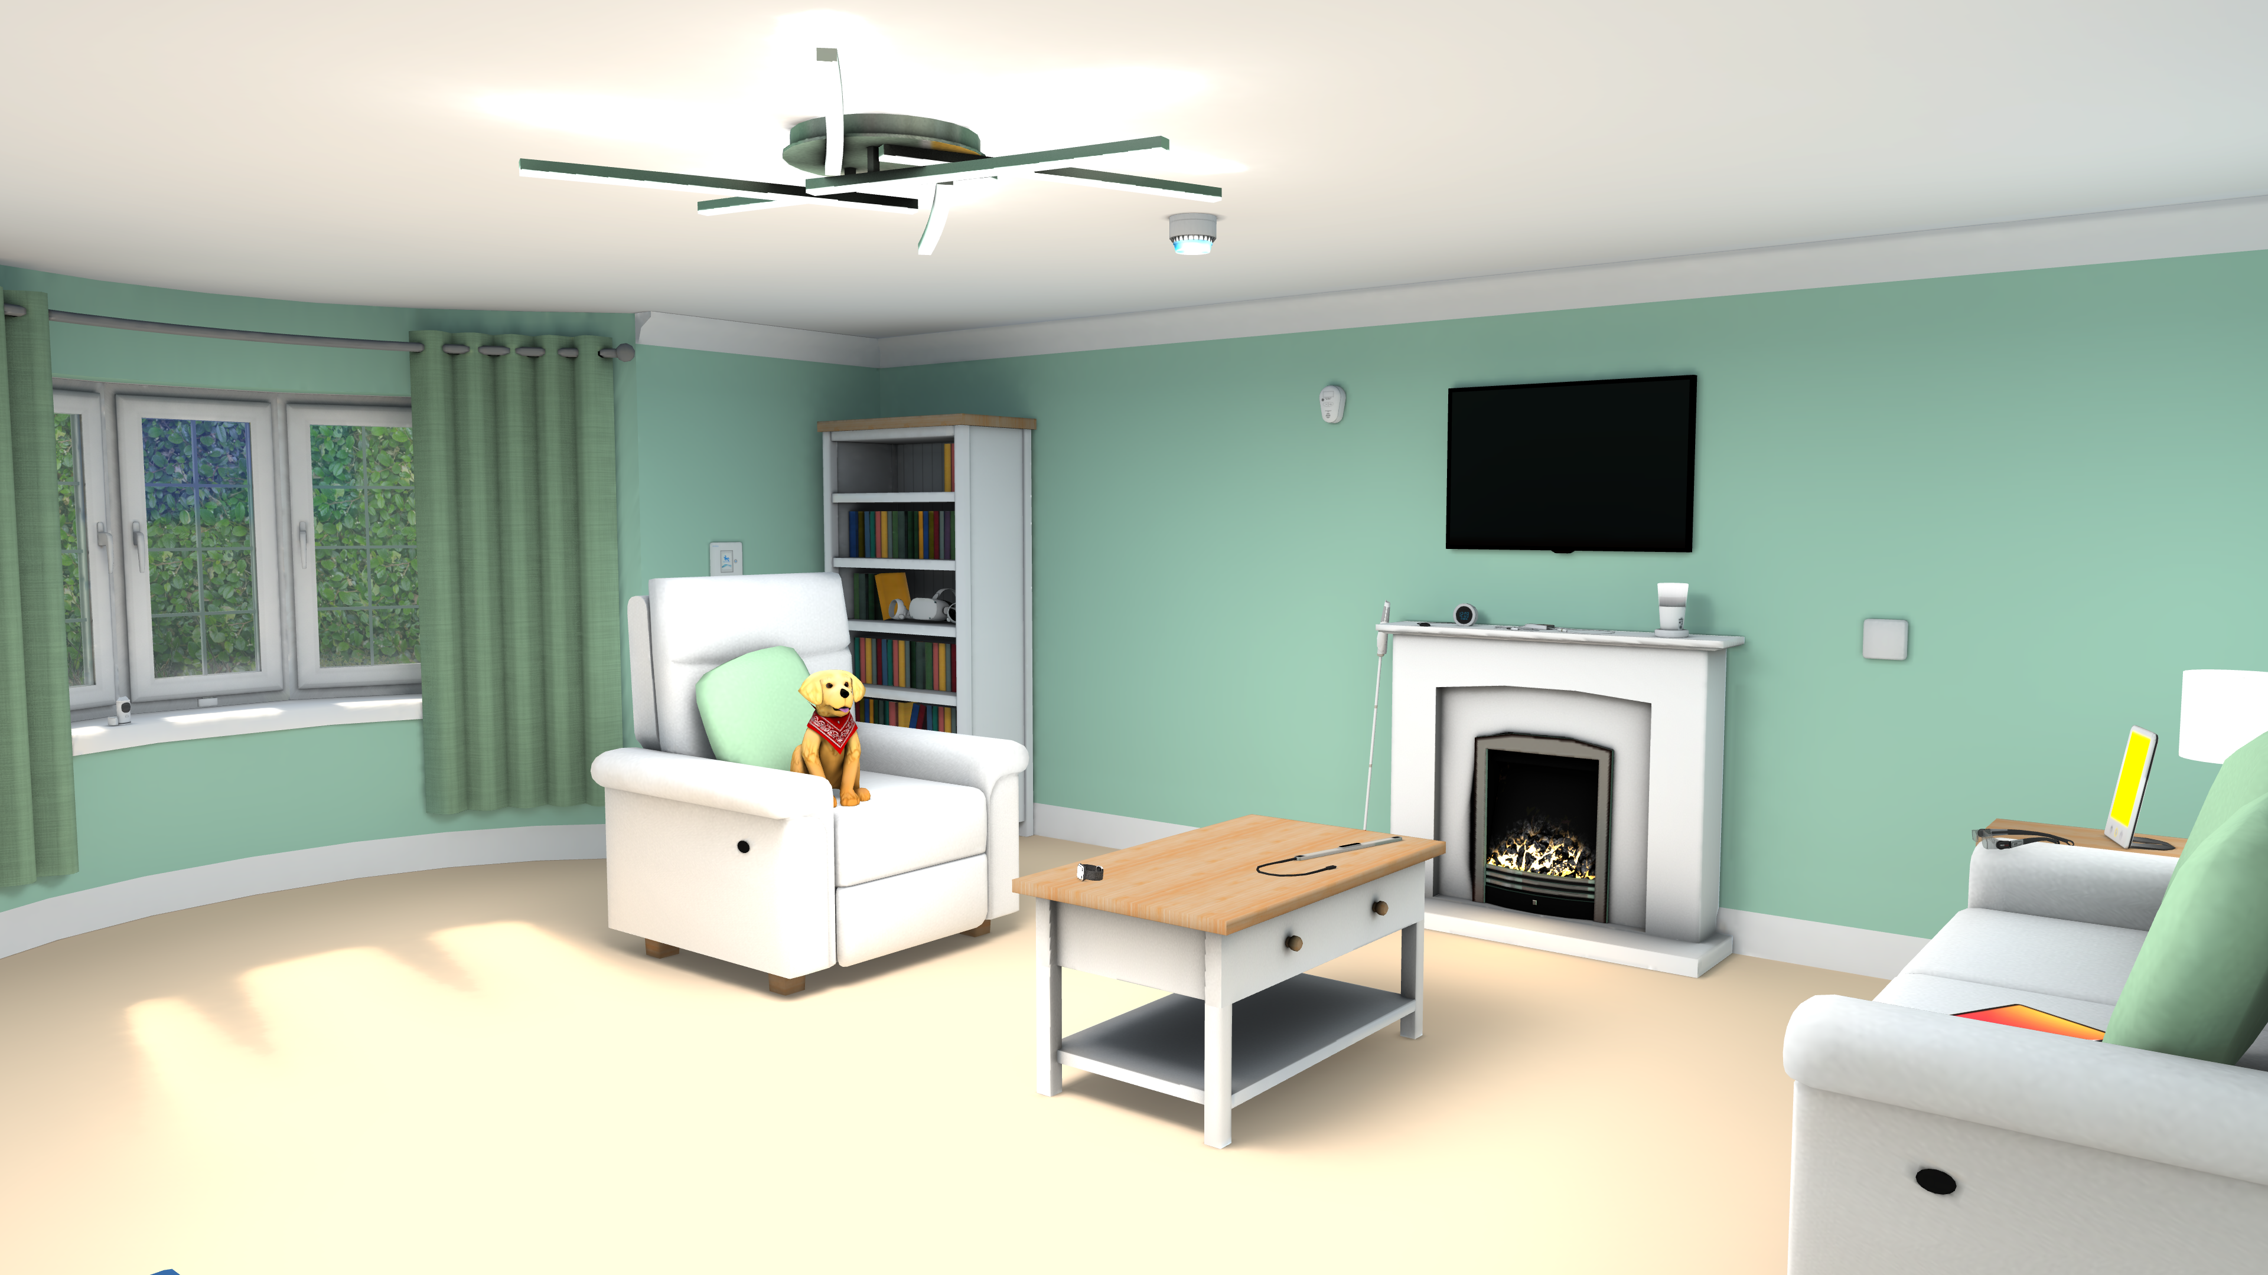
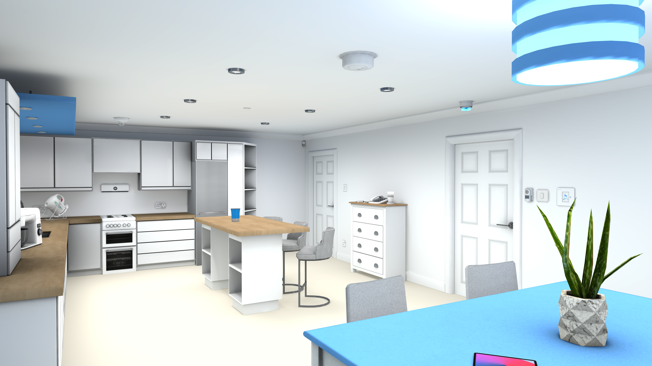
Virtual House

Slide 14
How aware of TEC are you?
Is TEC considered within a carers assessment?
Do you engage with your council TEC services to showcase technology to colleagues?
Your TEC awareness

Slide 15
People’s everyday lives enriched, enhanced and enabled by technology enabled care
Thank you
www.tsa-voice.org.uk

