Slide 1



Putting People at the Heart Forum
13th August 2024
Feedback from June and July…

Slide 2
Over A Brew Session
26 June 2024
Ethical use of Artificial Intelligence and Digital Technology

Slide 3


24 people attended the session to share ideas, insights and views... Over a Brew
Summary points of the Over a Brew discussion
Fears and Negatives of Artificial Intelligence
Positives Experiences with Artificial Intelligence
Opportunities for using Artificial Intelligence
Safeguarding Issues of using Artificial Intelligence

Slide 4

INTRODUCTION
This workshop focused on the ethical use of Artificial Intelligence and Digital Technology in the area of social care and support. We showed a video during the workshop about Artificial Intellience in Social Care which can be viewed on this page:
https://adasseast.org.uk/co-production/over-a-brew-virtual-coffee-sessions
We asked people who attended the session to think about the following questions:
    What were your feelings or thoughts while watching the film?
    In what ways do you think AI could make a positive difference in Social Care?
    What questions should we be asking about AI, and who should we be asking?
    What might we explore further regionally or locally in relation to social care?

Slide 5

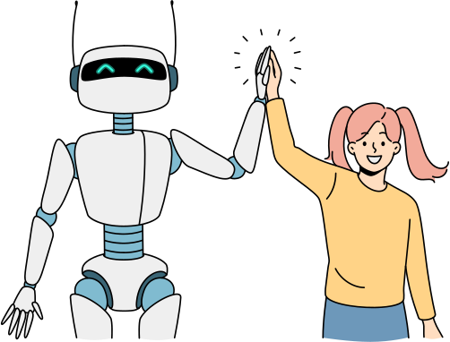
POSITIVES
A great example of where it works: Dementia Cat in a care home setting to help as a soothing tool
Would be good for language barriers
Using AI for voiceover
Provides equal or better outcomes
Fantastic Roadtrip Bus with AI - Phones which could translate languages = useful if English is not your first language
People using copilot/ChatGPT to write summaries or rewrite things in a way that is understandable.

Slide 6

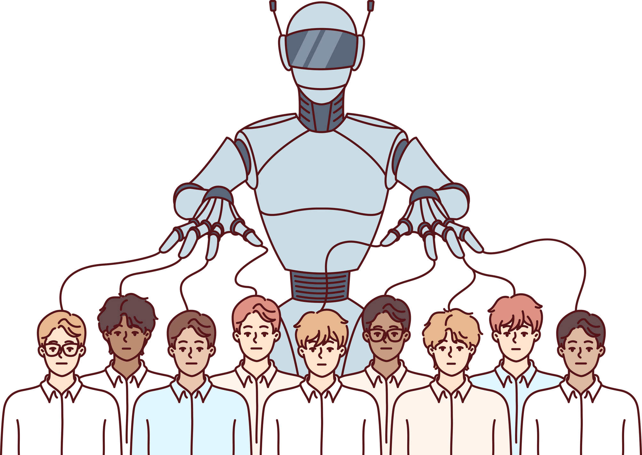
FEARS AND NEGATIVES
How intelligent is AI? Only as good as people that program it? What if they do not have relevant experience about what matters to people?
Why do we expect higher standards of behaviour or ethics from machines - why are we not listening as humans?
Concerned about limitations of poor data and programming and AI solutions being mis sold
Help the computer is taking over
You don't know if what you are being told is good for you or a political/organisation decision
Who is the robot here? People or machines? Why are we expecting machines to behave more humanly than we do ourselves?
Does it offer enough options for those who have to use it?
Danger of limiting options and solutions
What scares you most - mostly that managers think it will replace people or make decisions about someone's care
There are soon to be fully AI generated feature films - what happens to Art if AI can produce it all?

Slide 7
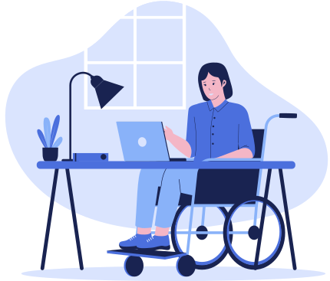
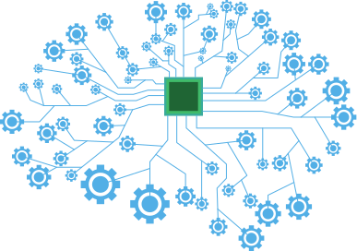

OPPORTUNITIES
Can simplify things and make things easier if used right
Wanting to integrate AI with the sensors etc that we use currently....
Some wonderful AI stuff that is helping people to communicate more effectively
Potentially liberating
for people with communication difficulties
ChatGPT being used by students to create essays, very quick way to organise information and workflow feels like an opportunity, can be used to support difficult things around rotas and staffing (if working together this can be effective)
Giving skilled practitioners a tool to enhance recording and spend more time with the people they work with
Freeing us up from the admin tasks that take time would be a big win
Using AI to write a helpful report suitable for ages 11+
Co-produce with the people it impacts on
Cost cutting
Older generation would need to be trained on how to use the system, such as in community hubs including libraries
Excitement: AI could automatically capture what has been said in a meeting rather than writing up assessments/care plans
I am also Autistic but AI is a help to me
There is potential to speed up some of the administrative stuff, so we can focus more on the human interactions etc...

Slide 8

SAFEGUARDS
Where is the control in social care going to come from
How do you ensure choice?
What happens if the AI is hacked?
Comes back to trust and making sure that the data and where it comes from is scrutinised
Better understanding with Health & social care as well as the complexities
Scares people if not explained correctly
Understanding of the physical system flow, tested before implementing the AI
Education and awareness of AI
Safety nets within the systems??
More needs to be done for the average person to see what AI is and isn't
How AI can be used with with big data to give indications on future care and highlight possible interventions, but it needs access to all the information
Could this be a cost cutting approach within social care
Important to ensure AI is used in the right context
Need to be careful not to lose human connection

Slide 9
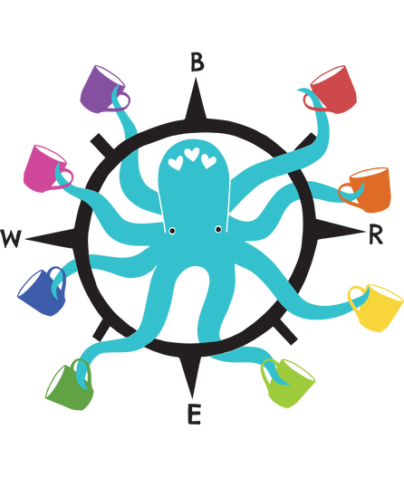
FINAL REFLECTIONS
So many useful applications
  One member of the group had attended a Roadshow bus on the use of AI and found it really informative. For example, there was a way for a phone to translate a language into English – the example given was translation of French to English.
  This could be really helpful if English is not the first language for a person who is accessing care and support.
  AI has been helpful in drafting reports, finding the right words, and ensuring the text was appropriate for the audience/agegroup being written for.
One size doesn’t fit all
  It is sometimes assumed that an AI Bot can answer all the questions but often it sends people in circles and doesn’t achieve the solution people are looking for.
Plenty of worries about AI
  Lack of privacy/fear of hackers/data being used which is out of date/taking away peoples jobs/the wrong language being used/AI taking over everything/losing choice and control/deliberately using false data or data which is not good in terms of the outcomes/lack of liability/dependence on tech and impact of this.

Slide 10
FINAL REFLECTIONS
If used in the right way and at the right time, AI can be helpful and has potential
  Alexa reminders/notifications for a person who accesses care and support, identifying risks and preventing risks, having conversations with people, reducing delays, communication through pictures, helping with decision making, potentially cutting costs in the long run, helping with language barrier.
AI needs to be trusted and the risks explained
  We expect a lot more from machines than we do of ourselves.
  The level of complexity is often underestimated and therefore, the wheels fall off
  Good tool but can’t replace everything.
Should be coproduced by the people who will be impacted by it
  People’s wellbeing needs to be considered.
  Money and resources need to be put into the right places to achieve better outcomes for the people we serve.
  There needs to be openness in what’s being offered and why and how it works.
  Everything should be considered in partnership such as across health and the social care landscape.

Slide 11


QUESTIONS FOR FUTURE SESSIONS
At what point do we say YES to AI - while it can crunch a huge amount of data -
At what point do we as humans need to stop being part of the process (if at all?)
Want to go away and look more at what the gaps are, not just using AI for the sake of it.
Key question of AI as autonomous or assistive?
Do we get to the point where we stop needing clinicians -
opens a box of ethical questions etc…
Take a moment to appreciate how you as a person are being exposed to AI and the message/promises behind that exposure...
Tap into the digital network - to host this conversation?
And to learn from people about what is happening regionally and nationally…

Slide 12
Over A Brew Session
24th July 2024
EDI

Slide 13
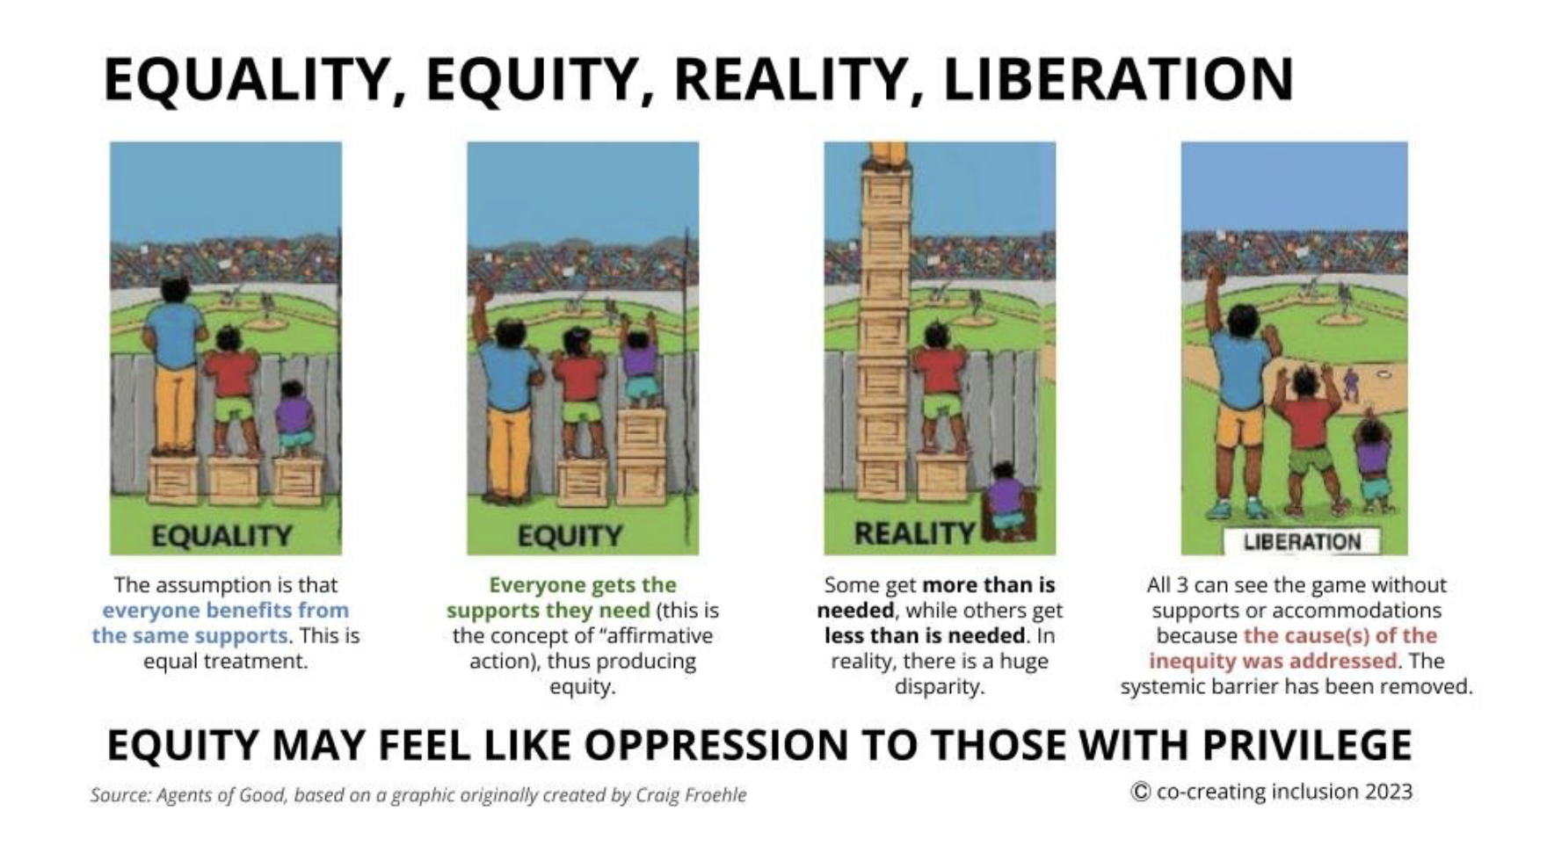
A new way of thinking about EDI

Slide 14
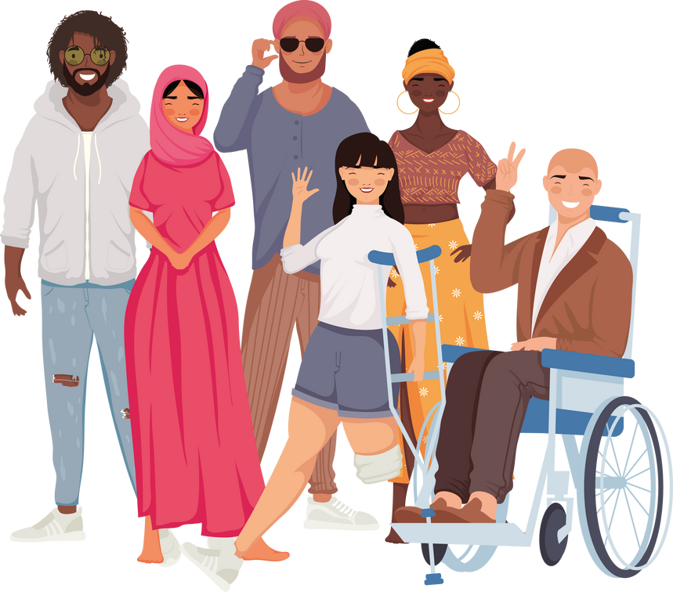
In a space where voices intertwine, A sanctuary where hearts align,
We gather here, from far and near, To share our stories, free of fear.
Though different paths our lives have paved, In this haven, all is saved.
Each tale a thread in the tapestry, We weave a quilt of unity.
Our ways of being, unique and bright, Illuminate this space with light.
Though we may not always see, The same horizons, we agree.
To listen deeply, to hold and care, In every word, we're truly there.
Understanding may not always come, Yet respect's beat on every drum.
In professional, in personal stride, We walk together, side by side.
A held space, where all belong, In harmony, we sing our song.
With open hearts and open minds, In each other's stories, we find,
The beauty of diverse design, In this sacred, shared shrine.
So let us gather, let us be, A testament to unity.
For in this space, we've come to see, The strength in our diversity.
Isaac Samuels

Slide 15
When you hear the phrase EDI - what comes to mind?
EDI to me means the uniqueness of every person
It means such a lot - hard to describe briefly! But I love the inclusion aspect :)
Not necessarily treating everyone the same but more recognising everyone is an individual and recognising and accommodating their differences
I sometimes think it can be overwhelming - how do I get it right? But when we do get it right it is amazing.
EDI for me is about equality of voice and ensuring no hierarchy of opinions where everyone is valued
Equality, Diversity and Inclusion..... as acronyms often hide the actual issue(s). And no part of this topic should ever be hidden else we accept hiding our unconscious prejudices.
understanding of quality in the life as a disabled person ensuring that we can lead a fulfilling, equitable and dignified life
EDI means not forgetting that some people will need help from others to represent their views, in order to be included.

Slide 16
Key learning….
Reward and Recognition
**Importance of Reward and Recognition**:
Acknowledging and valuing contributions is crucial.
Inclusivity and Diverse Voices
**Hearing More Voices**: Efforts must be made to include a variety of perspectives.
**Move Away from Tick Boxes**: Actions should be genuine and not just for appearances.
**More Variety in Voices**: Representation from diverse backgrounds is essential.
**Intersectionality**: Recognize and respect the multiple dimensions of individuals’ identities.
Power Dynamics and Equality
**Equal Power Distribution**: Strive for equality by sharing power with all participants.
**Imbalance of Power**: Acknowledgement that power imbalances still exist in co-production spaces.
**Equity vs. Equality**: Equity ensures everyone has the right opportunities to make things fair, beyond just equal treatment.

Slide 17
Key learning….
Genuine Engagement and Systemic Change
**Move Beyond Discussion to Action**: Since the Equality Act, minimal change has been observed.
**Breaking Barriers**: Understand and address subtle challenges and systemic barriers.
**Authenticity and Acceptance**: Encourage genuine self-expression and acceptance of diverse identities.
**Systemic Changes**: Inclusion needs to be an integral part of how systems are designed and implemented.
Perceived Barriers and Practical Challenges
**Budget Constraints**: Budget issues can lead to a checkbox approach; need to find ways to overcome this.
**Carers’ Voices**: Carers should have opportunities to input into service design and receive support.
**Accessibility of Co-production**: Ensure co-production activities are accessible in terms of timing, format, and participation.
Identity and Belonging
**Cultural Acceptance**: Struggles of being accepted as British while being from a minority background.
**Positive Curiosity**: Engage with people’s backgrounds in a respectful and curious manner.
**Diversity in the Workforce**: Inclusion should also consider those working in services, not just service users.

Slide 18
Final reflections…
Hate the acronym - what does it stand for! Its a bittersweet thing - great to talk about it - but the bitter side is being a topic on the agenda of my daily life - a topic that is slotted in between other things -that's hard for me. Even in the conversation it does feel that its a tick box thing that I have attended EDI training - and then things don't change...
Things to reflect on - the issue of being invited to 'represent' a particular group - how do we avoid this - is about having the conversation like this - Over A Brew - being brave - and learning from one another and calling things out.
One thing we haven't touched on today is values - the fundamentals of how we expect to be worked with - with dignity and respect and kindness - value approach is so important for this.
Make sure this session feeds into the Diversity and Equality Group as well as the Putting People at the Heart of Care and Support Group - raise awareness and plant seeds for change
I'm taking away a reminder that there is more that unites us than separates us, and we can all learn from each other.
Thank you for this space and the generosity shown by people willing to share their experiences. I will take time to think through today's session, both personally and professionally. A rich discussion.
I need to do more in my workspace and in my outside life to break down the barriers Reality > Liberation

Slide 19
And Finally - Face to Face Gathering 10th Sept 2024
Flyer - please invite at least one other person with lived experience…
What would be helpful for you to do this in terms of invitation/ information?
Think about other people working in social care in your area who might benefit, have something to contribute.
Please nominate someone else if you can't make it - our aim is to have representation from ALL the local authorities of at least one person with lived and one person with professional experience.

